Slide 1
Korisničke priče

Slide 2
Korisničke priče
As a <user role> (or system), I want to <goal> so that <benefit>
Iskazuju suštinu bez suvišnih detalja (detalje ustanove članovi tima)
Kriterijumi prihvatljivosti (acceptance criteria)
Identifikator
How to Demo checklist

Slide 3
INVEST
Independent
Negotiable
Valuable
Estimable
Small
Testable

Slide 4
Primeri
As a user, I want to post a resume.
As a user, I want to add a new resume to the site.
As a user, I want to edit a resume that is already on the site.
As a user, I want to remove my resume from the site.
As a user, I want to mark a resume as inactive so that employers cannot send me job offers for some time.
As a user, I want to mark a resume as hiddent from certain employers.

Slide 5
Kriterijumi prihvatljivost
Verifikacija da su korisničke priče implementirane tako da rade onako kako klijent to očekuje
Primer: As a user, I want to pay for the items in my shopping cart with a credit card.
Test with Visa, MasterCard and American Express (pass)
Test with a Diner’s Club (fail)
Test with a Visa Debit card (pass)…

Slide 6
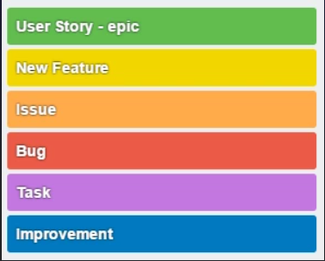
Labele

Slide 7
Prioritet
Sortiranje kartica
Dodavanje polja Importance
Dodeljuje Product Owner

Slide 8
Story poeni
Koristi se modifikovan Fibonačijev niz ( ½, 1, 2, 3, 5, 8, 13, 20, 40, 100)
Planning poker
Brzina tima

Slide 9
Task
Nakon preuzimanja US, potrebno je dekomponovati ga na zadatke (taskove)
Definišu se nakon US
Opisuje kako nešto napraviti, a ne šta napraviti

